Slide 1
LAB3: UNIT TESTING

Slide 2
Unit Testing In Software Development Life Cycle (SDLC)
Unit Testing is not a new concept. It’s been there since the early days of programming.
Unit tests to improve code quality by verifying every unit of the code used to implement functional requirements.
Test drove development (TDD) or test-first development.
Done by developers and sometimes White box testers

Slide 3
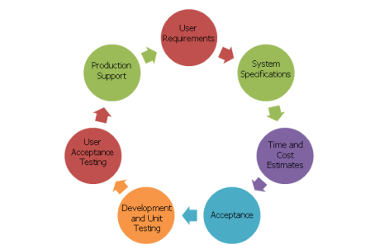
Unit Testing In SDLC

Slide 4
Unit Testing In SDLC
Unit Testing is used to design robust software components that help maintain code and eliminate the issues in code units.
Finding and fixing defects in the early stage of the software development cycle.
It is an related part of the agile software development process.
If we set this as a standard process, many defects would be caught in the early development cycle, saving much testing time.
Notes:
Many developers hate to write unit tests. They either ignore or write bad unit test cases due to tight scheduled or lack of seriousness (yea they write empty unit tests, so 100% of them pass successfully.
It’s important to write good unit tests or don’t write them at all.

Slide 5
Unit Testing Methods
It can be performed in 2 ways :
Manual Testing
Automated Testing

Slide 6
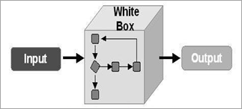
Techniques Within Unit Testing
White box testing
the tester knows the internal structure of the software including the code
The tester can test it against the design and the requirements
white box testing is also known as transparent testing.

Slide 7
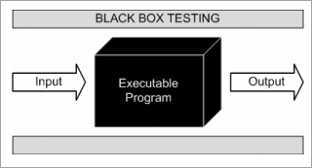
Techniques Within Unit Testing
Black box testing
the tester does not know the internal structures either the code of the software
Notes:
Robust: mạnh mẽ
Integral: Liên quan

Slide 8
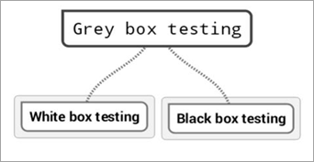
Techniques Within Unit Testing
Grey box testing
The grey box is considered as a combination of black box and white box testing techniques (Semi-transparent technique testing).
The testers are only partially aware of the internal structure, functions, and designs along with the requirements
Notes:
Robust: mạnh mẽ
Integral: Liên quan

Slide 9
Benefits Of Unit Testing
The process becomes agile
Code quality improves
Detects bugs early
Easier changes and simplified integrations
Documentation availability
Easy debugging process
Lower cost
Code completeness can be demonstrated using unit tests
Saves development time
Code coverage can be measured

Slide 10
How to write good Unit Tests?
A Unit test should be written to verify a single unit of code and not the integration.
Small and isolated Unit tests with clear naming would make it very easy to write and maintain.
Changing another part of the software should not affect the Unit test if those are isolated and written for a specific unit of code.
It should run quickly
A Unit test should be reusable

Slide 11
Lab 3
Nhóm: sử dụng nhóm đã đăng ký.
Nội dung: Lựa chọn một công cụ ở slide 12 để nghiên cứu và thực hiện UT.
Báo cáo: (sử dụng template UT Test case kèm theo bài post)
UT Test case
Báo cáo Test
Cơ cấu chấm điểm
Không có bài :0 điểm.
<500 LOC :1-4 điểm.
500- 1000 LOC :5 điểm.
1001-1500 LOC :6 điểm.
1501-2000 LOC :7 điểm.
>2000 LOC :8 điểm.
Độ khó của bài UT :0-2 điểm

Slide 12



Popular Unit Testing Tools
Guide (Vietnamese)
Giới thiệu JUnit - GP Coder (Lập trình Java)

Slide 13
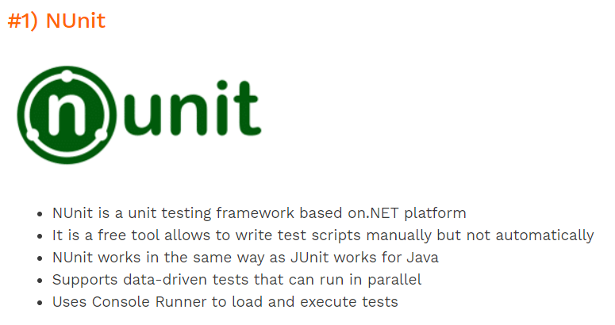

Slide 14


